Slide 1
What We Get: METplus Verification Outputs
METplus runs routine NWP verification and writes
results to structured output folders.
Each configuration produces a folder named:
<Model>_<Obs>_<Parameter>_<Timestep>
Inside each folder are daily YYYYMMDDHH
subdirectories, each containing .stat files
for every forecast lead time and domain.
Two types of verification output:
GridStat - deterministic scores
(bias, RMSE, MAE)
EnsembleStat - ensemble scores
(CRPS, Spread, Skill Score)
input_all/
AGlobal4_Analysis_T_AllLevels_00Z/
AGlobal4E_Analysis_T850_00Z/
GridStat/ 2026041000/
GridStat/
EnsembleStat/
_cnt.txt
_sl1l2.txt
_sal1l2.txt
_cnt.txt
_ecnt.txt
Legend
GridStat
Deterministic (CNT, SL1L2, SAL1L2)
EnsembleStat
Ensemble (ECNT)

Slide 2
Why Parquet?
Moving from hundreds of daily .stat files to a single, portable, queryable dataset per model.
Columnar Storage
Compressed by Default
Self- Describing
Python Native
Reads only the columns you request. Skip irrelevant fields entirely - no scanning of full rows.
5-10x smaller than CSV. Snappy compression is applied automatically. Fits on a USB drive.
Schema, data types, and metadata all embedded in one file. No separate DDL or config needed.
One line to load with pandas. Filter columns before reading with pyarrow - no SQL needed.
vs a SQL database: no server to install, no connection strings, no schema migrations, no DBA required. Share your verification data as a single .parquet file - it opens in one line of Python on any machine.
df = pq.read_table("AGlobal4_Analysis.parquet", filters=[("PARAMETER","=","MSLP")]).to_pandas()

Slide 3
What We Do: Conversion Pipeline
Input Folders
Read & Parse
Merge & Clean
Group by Model/Obs
Parquet Files
<Model>_<Obs>_<Param>_<TS>
GridStat/ or EnsembleStat/
YYYYMMDDHH subdirectories
CNT, SL1L2, SAL1L2
(GridStat)
ECNT (EnsembleStat)
Drop metadata cols
Convert lead to hours
Add PARAMETER column
Numeric type casting
One output per
model + obs pair:
AGlobal4_Analysis
AGlobal4E_Analysis
One .parquet per
model/obs pair
All parameters
All timesteps
Re-running is safe - already-loaded init dates are skipped per PARAMETER and STAT_TYPE

Slide 4
What the Outputs Look Like: Parquet Schema
Each row = one unique combination of init date, lead time, pressure level, domain, parameter, and stat type.
PARAMETER
STAT_TYPE
INIT_DATE
FCST_LEAD_H
FCST_LEV
VX_MASK
ME / RMSE / MAE
CRPS / SPREAD
T_AllLevels
GridStat
2026-04-10
24
P850
Australia
-0.5 / 1.87 / 1.43
-
MSLP
GridStat
2026-04-10
48
L0
NH
0.3 / 2.1 / 1.8
-
T850
EnsembleStat
2026-04-15
24
P850
NH
0.28 / 3.26 / 2.26
1.62 / 2.73
Wind_All
GridStat
2026-04-15
72
P250
SH
0.1 / 2.4 / 1.9
-
Index columns
GridStat stats
EnsembleStat stats
Constant columns (model, variable, units, obs type) are stripped from rows and embedded as file-level metadata.

Slide 5
How We Can Use the Data
Single Model Exploration
import pyarrow.parquet as pq
# Load a model dataset
g4 = pq.read_table(
'AGlobal4_Analysis.parquet'
).to_pandas()
# Filter to one parameter
t = g4[g4['PARAMETER'] == 'T_AllLevels']
# Cross-model comparison
g4e = pq.read_table(
'AGlobal4E_Analysis.parquet',
filters=[('PARAMETER','=','MSLP')]
).to_pandas()
# Ensemble stats only
ens = g4e[
g4e['STAT_TYPE'] == 'EnsembleStat']
Load one model's file, filter to a parameter,
level and domain, and plot any metric by lead time.
Cross-Model Comparison
Load two files side-by-side, filter to the same
parameter and domain, and compare RMSE or bias.
Ensemble Diagnostics
Filter STAT_TYPE = EnsembleStat to access CRPS
and Spread. Check Spread ~ RMSE for calibration.

Slide 6
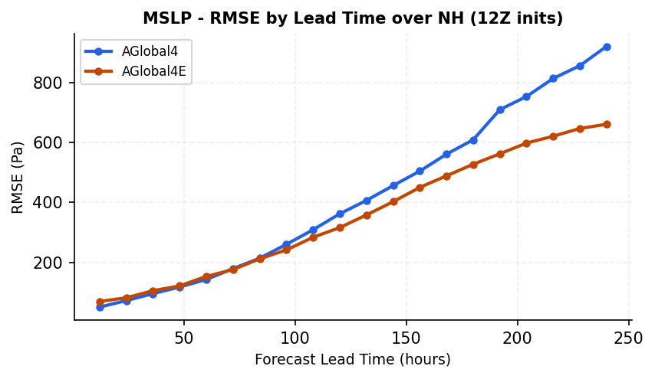
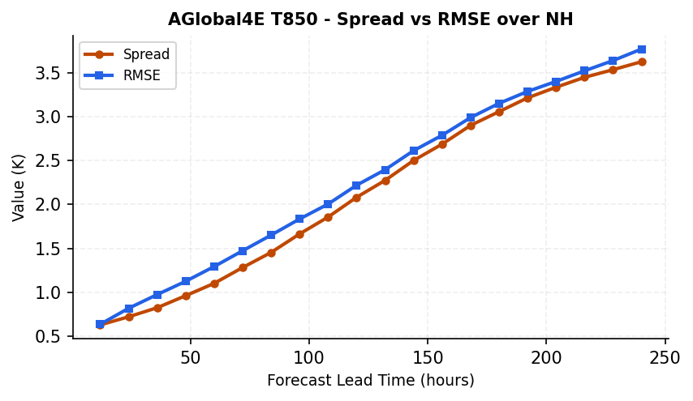
Example Results
Cross-model comparison: MSLP RMSE by lead time over NH (12Z inits only).
Ensemble calibration: Spread ~ RMSE indicates a well-calibrated ensemble.
Load: pq.read_table("AGlobal4_Analysis.parquet", filters=[("PARAMETER","=","MSLP")]).to_pandas()
Filter: df[df["STAT_TYPE"] == "EnsembleStat"] | df[df["VX_MASK"] == "NH"]

